Slide 1
Presentation
Jiayu Chen
2024.04.08

Slide 2
Outline
Part_1: Heartbeat Simulator
Part_2: Paper Writing
Part_3: Arrhythmia

Slide 3
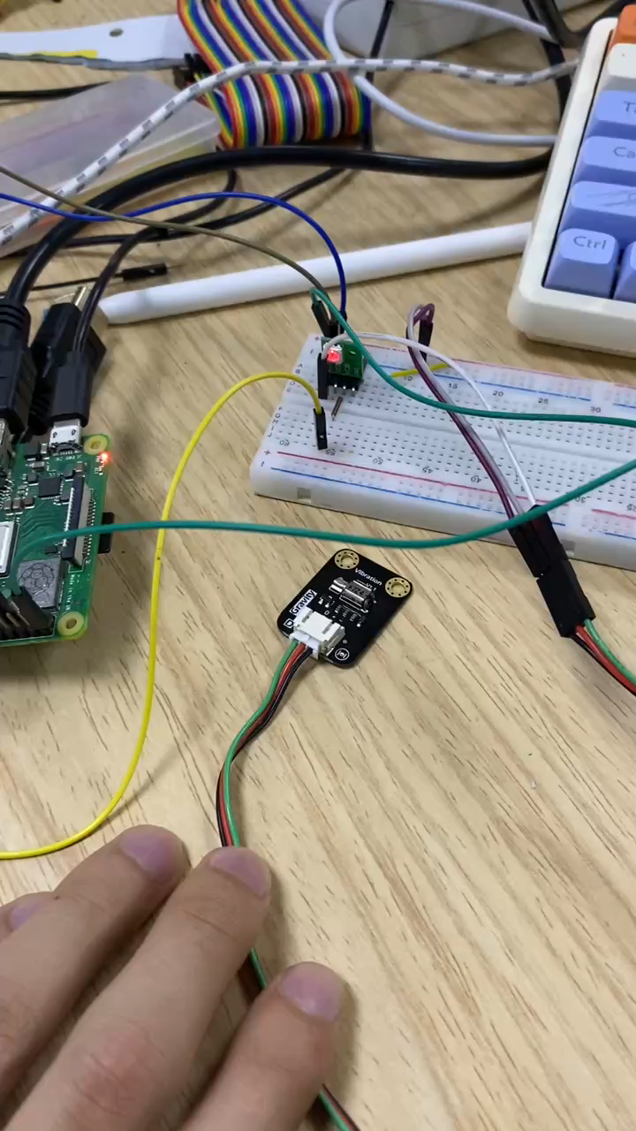
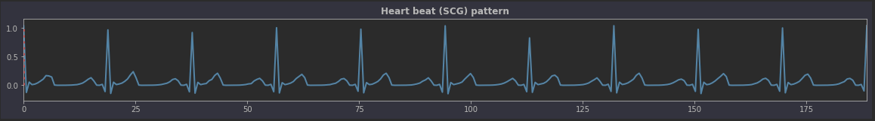
Heartbeat Simulator
Map positive amplitudes to a range of 0-100% and drive the motor/red light accordingly in terms of intensity. When amplitude is negative, stop vibration and flash blue light. Control voltage directly without using a DAC Board.
In my understanding, we aim for BedDot to receive simulated signals similar to BSG. The specific vibration pattern of the motor might require trials.
Is there a way to directly convert or deduce the vibration pattern of the motor from existing BSG signals?
Notes:
将正值的 Amplitude 映射到 0-100%。按照对应的强度驱动马达/红色灯光，
Amplitude为负值的时候停止了震动，闪蓝光。
直接控制电压，没用到DAC Board。
在我的理解里
实际上我们希望用BedDot接收到类似于BSG的模拟信号
马达具体是如何震动的，是不是需要一点一点的try。然后不停的改变马达震动的模式，直到接受到的模拟信号是符合预期的。
接收到BSG信号的 电机的震动模式 是逐渐try出来的。还是有办法通过已有的BSG信号直接转换或者反推出来？

Slide 4
Paper Writing
Preprocessing
Professor Xie mentioned that if he reviews the paper, he will definitely raise questions about how to filter the noise signals from the device.
Should we include this? If so, how much space should we allocate for it? Also, would there be any issues if we directly adopt the methods from IoT2023?
Comparison Experiments
Professor Xie believes that the following experiment is very important.
Bed
dot
Bed
dot
Bed
dot
Bed
dot

Slide 5
Paper Writing
Collaborators
Professor Xie will provide overall guidance, but the details will mostly be up to us. He doesn't have time to get involved in hands-on revisions of wording.
Yingjian is also quite busy and won't be able to help with hands-on revisions. Yingjian and I are separated by a time difference, making effective communication difficult.
Yida and I discussed, and he will help me complete several baselines.
There's a classmate whom I hope to involve. I want him to assist in collecting simulated signals and together we can handle the detailed revisions in writing.

Slide 6
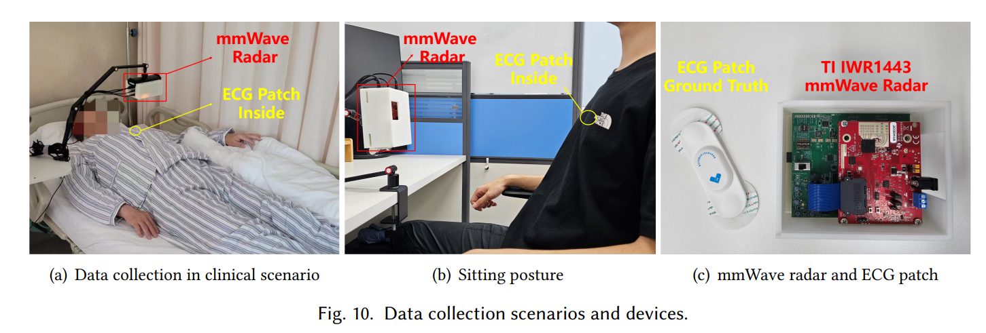
AFib
Langcheng Zhao, Rui Lyu, Qi Lin, Anfu Zhou, Huanhuan Zhang, Huadong Ma, Jingjia Wang, Chunli Shao, and Yida Tang. 2024. mmArrhythmia: Contactless Arrhythmia Detection via mmWave Sensing. Proc. ACM Interact. Mob. Wearable Ubiquitous Technol. 8, 1, Article 30 (March 2024), 25 pages. https://doi.org/10.1145/3643549
2023. Carepulse Patch. https://index.carepulse.cn/home/index.html . Accessed July 4, 2023.

Slide 7
AFib
IBI
Model
Normal / AFib
Whether the model is learnable or a set of indicators summarized from existing research depends on the collected simulated data.

